Slide 1
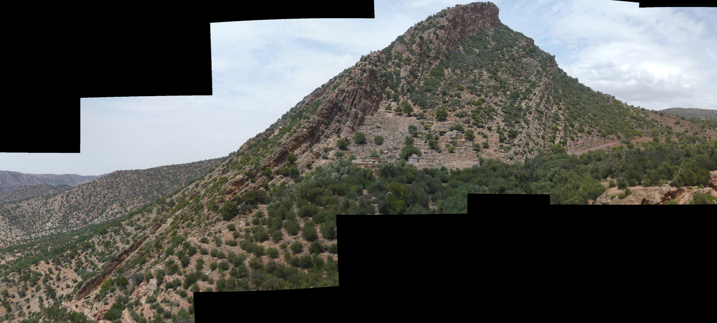
Outcrop overview
Oxfordian

Slide 2
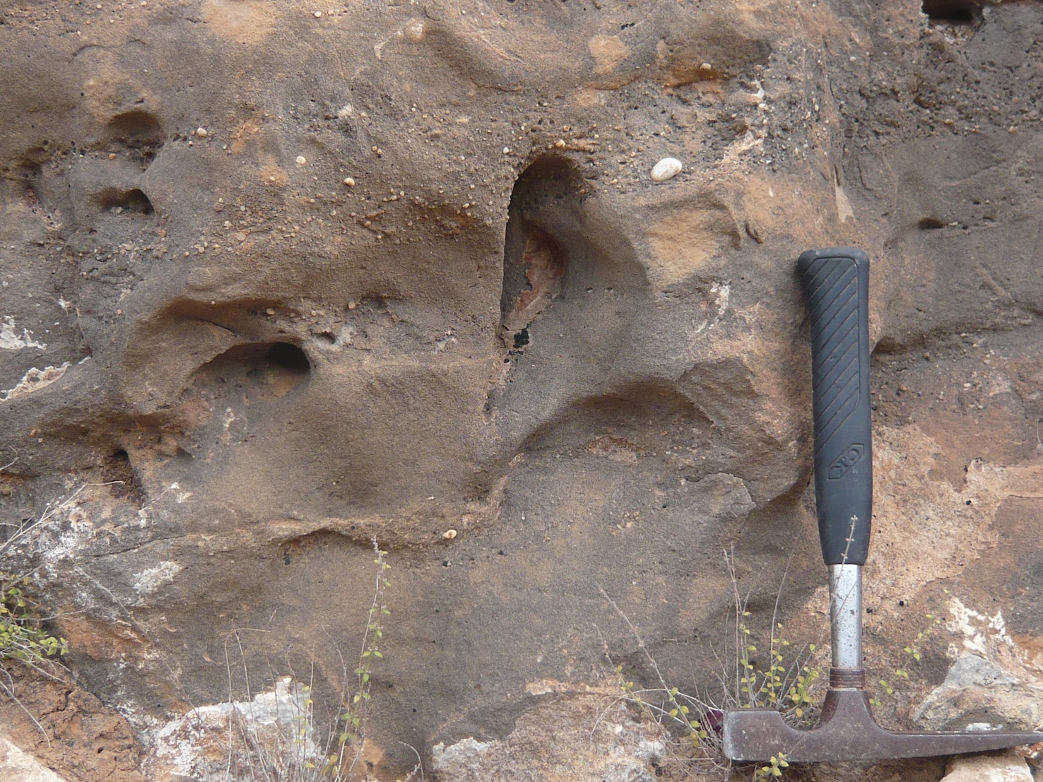
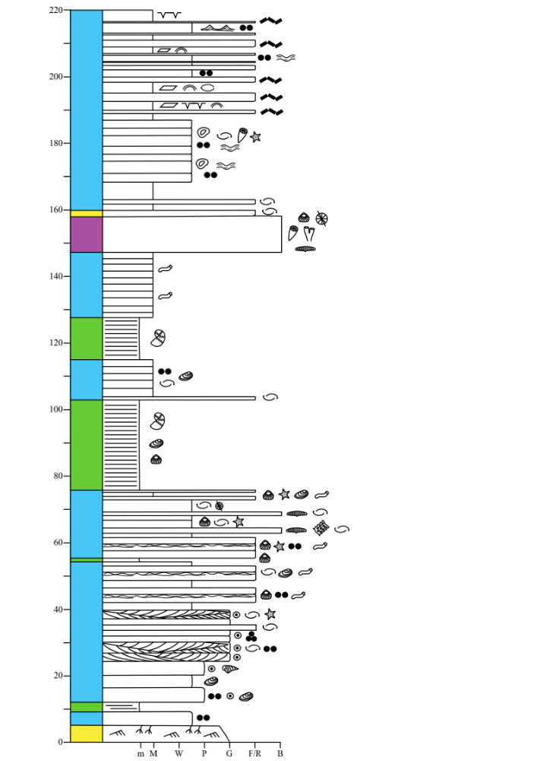
Unit 4a: Oxfordian
(4.10)
The buildup is overlain by a different lithology.
What are its components and sedimentary structures?

Slide 3
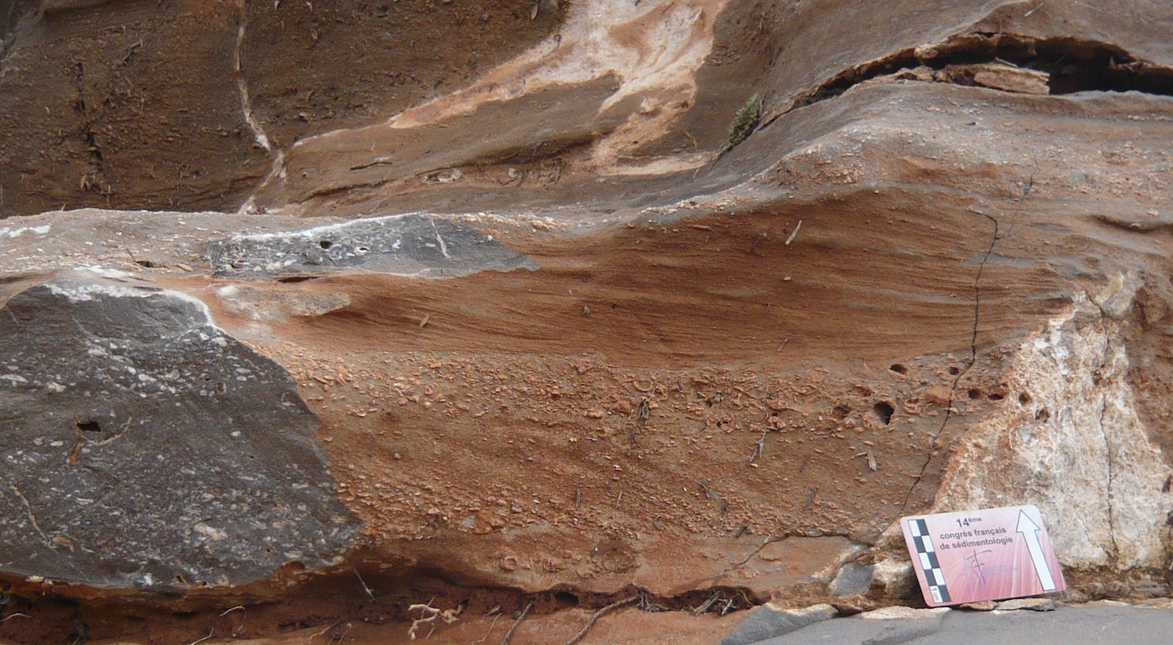
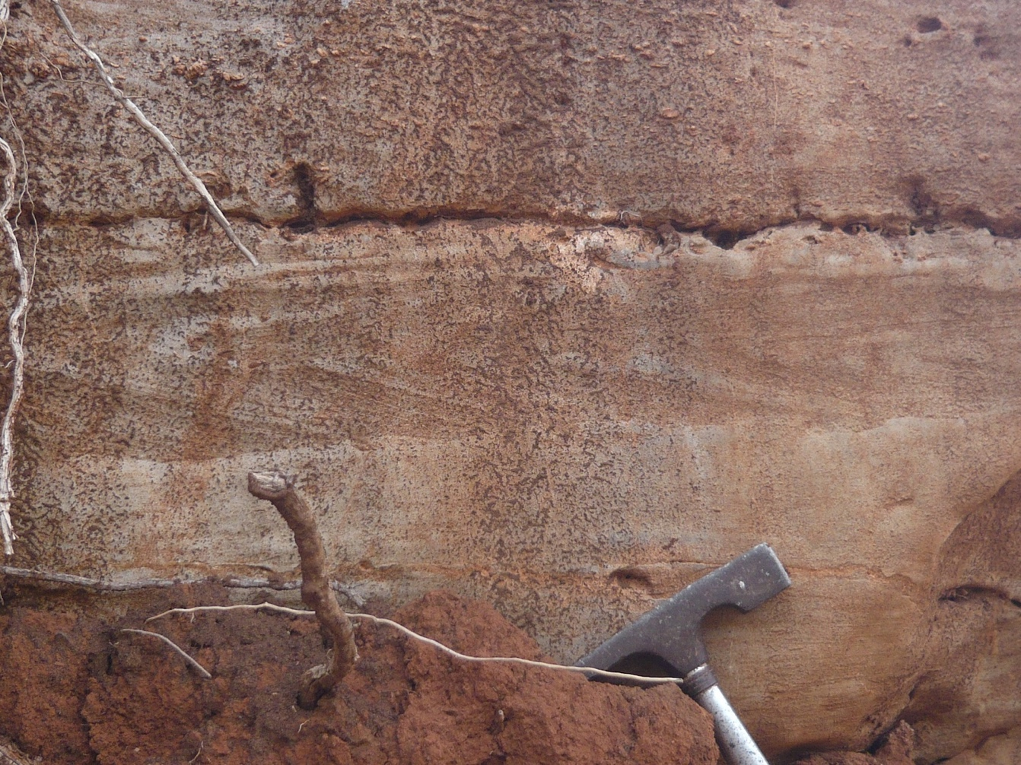
Unit 4a: Oxfordian
(4.11)
(4.12)
What do these observations imply for sedimentary processes and the overall environmental interpretation?

